Slide 1

Making DSLs conversable
Krishna Narasimhan,
Notes:
Motivation behind this work: bridging accessibility and reliability in domain-specific systems.
How many times have you built something powerful that no one could use?
Amazing tech that is hard to use.

Slide 2
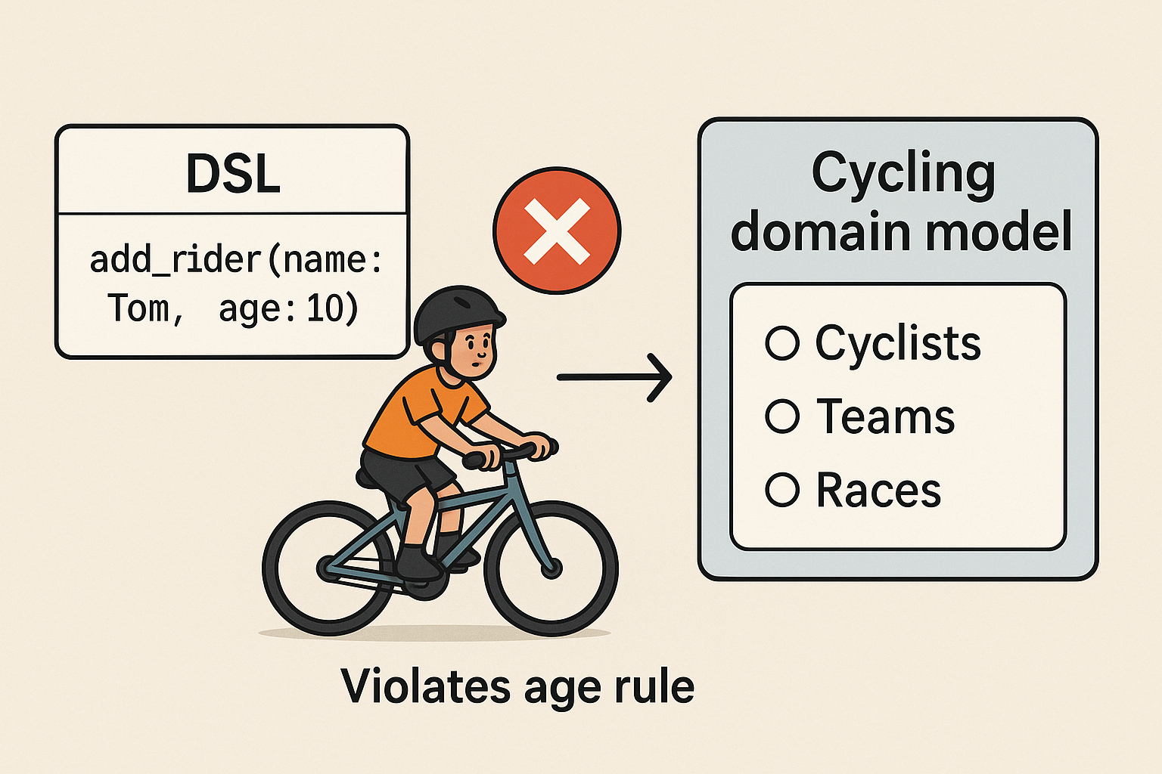
DSLs are great
DSLs model complex domains with precision.
They ensure valid, rule-consistent operations.
Example: cycling domain model enforcing age limits or team structure.
Notes:
DSLs capture the structure and constraints of a domain directly - every valid operation must adhere to rules (e.g., a child cannot be added as a professional rider).
Verification win: can prove no invalid states
Maintenance win: change rule once, applies everywhere

Slide 3
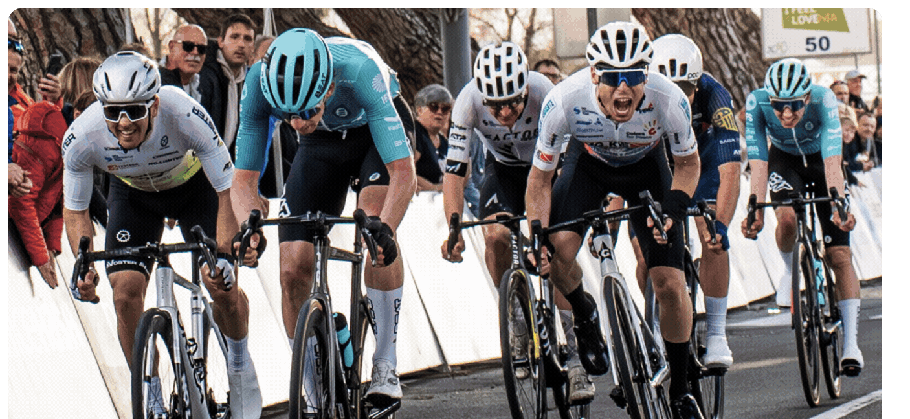
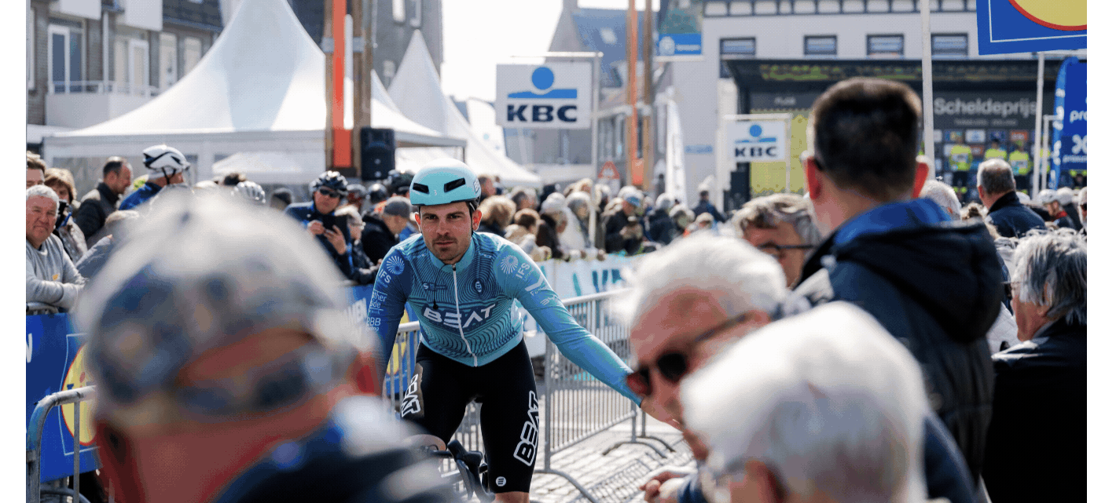
Use case: BEAT Cyling Club
Talent prediction for cycling pro’s
Race results combined with secondary data (weather, location, training data, equipment)
Problem:
Users without ANY tech skills
Users have very limited time
Notes:
BEAT Cycling Club is an ambitious pro cycling team aiming for top-tier competition
Success requires smart race planning balancing fatigue, skill, and goals across a season
For some races, the goal isn’t always to win sometimes scoring points matters more
They needed a structured way to analyze riders, assign races, and manage performance data

Slide 4
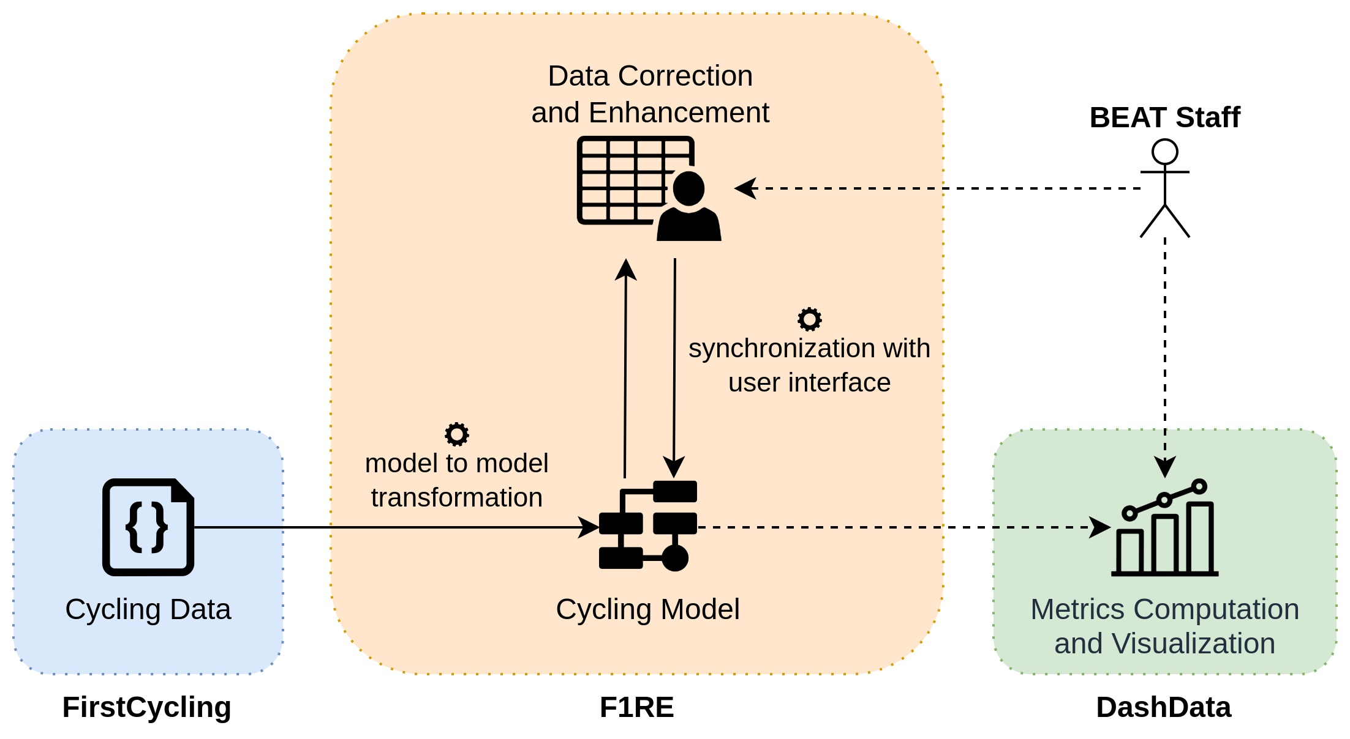
Notes:
So we modeled their world.
Imported data from FirstCycling (goto source for cycling race related data)
Polished the collected data and they hooked it up to a BI system (DashData)
But still…this is one level lower abstraction for the BEAT folks.

Slide 5
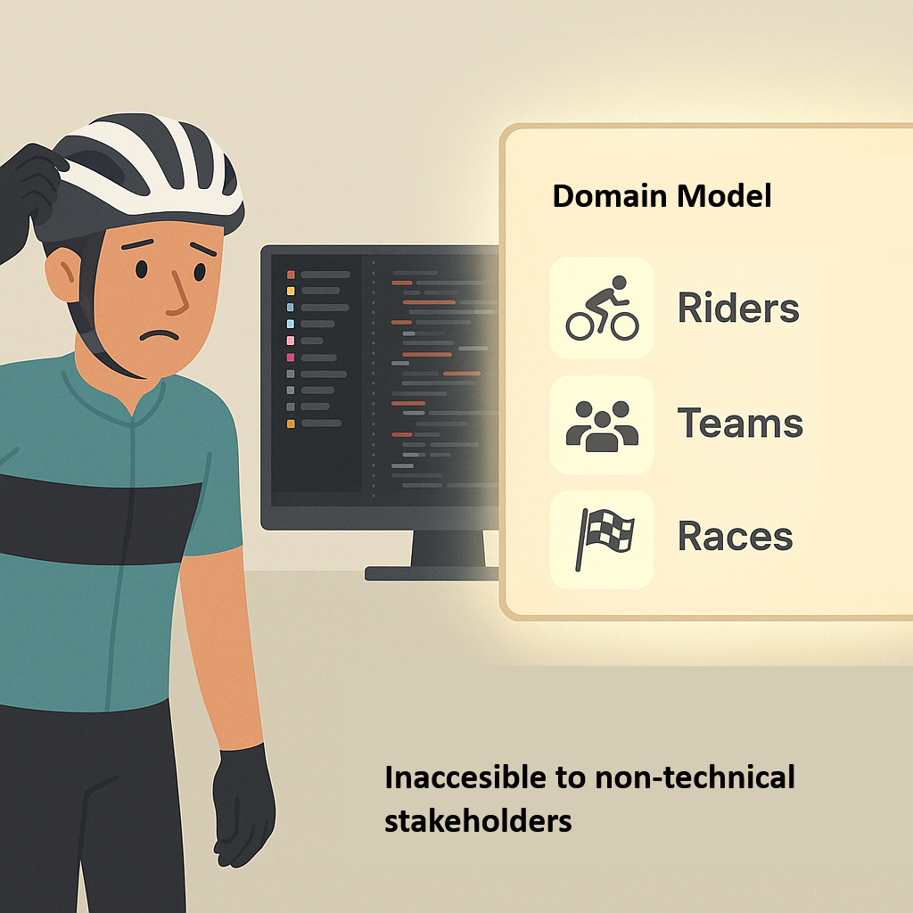
Accessibility issue
Complex syntax
Special tooling required
Limited documentation
Steep learning curve
Risk of expensive shelf-ware
Notes:
Transition point: emphasize that although this makes DSLs powerful, it also makes them difficult to access for non-technical users.
Data scale: scraped FirstCycling.com
Built sophisticated simulation engine Sports directors aren't coders
Risk: expensive shelf-ware
Need translation layer
Training time: weeks minimum
Tool overhead: IDE setup, plugins, configs
Documentation gap: who maintains DSL docs? Error messages: "Parser error at line 42" means nothing to them Productivity cliff before climbing back up

Slide 6
Why not teach* an LLM and ask it for help?
* Fine-tuning, Prompt prefix, RAG
Notes:
But accessibility is solved through LLM?
Dump your data (fine tune in some form to the LLM (teach it your domain essentially). And pray to the AI gods it will respect the structure and semantics of your domain.

Slide 7
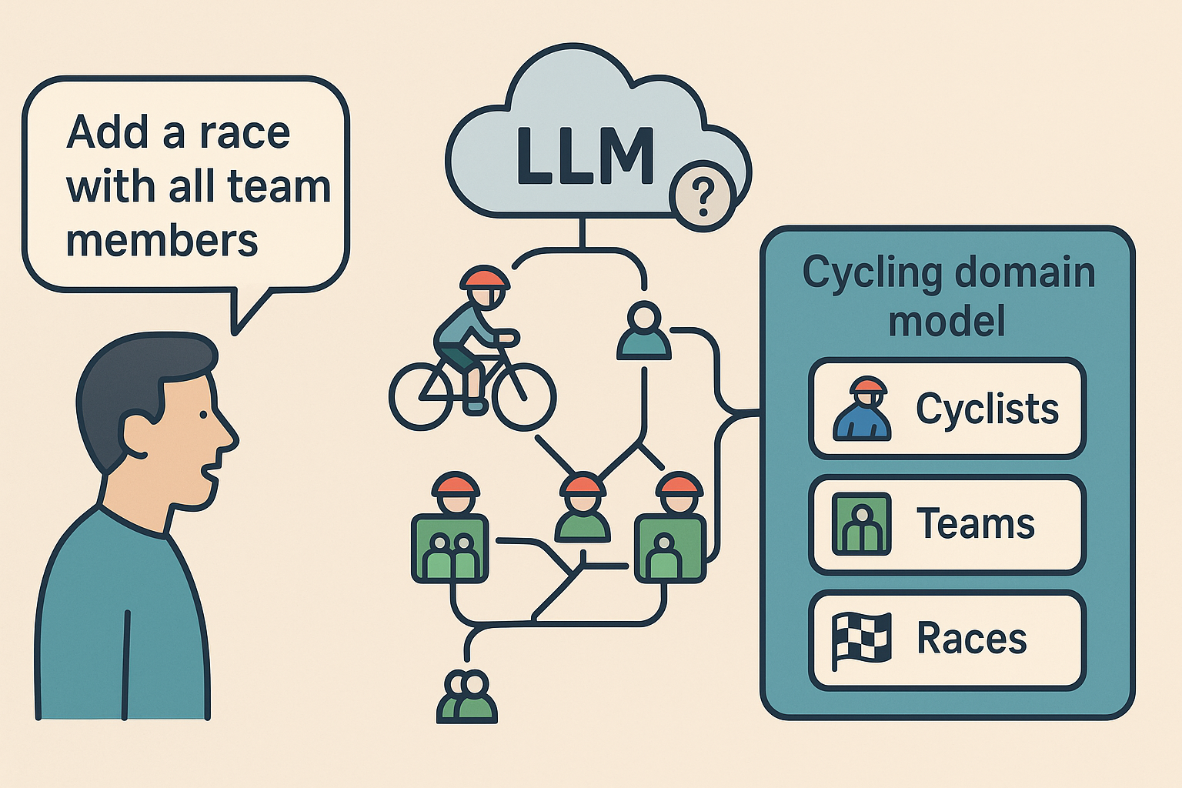
LLMs ≠ Domain Understanding
Words, not structure
Confuses relationships
No rule awareness
Sounds right, acts wrong
“LLMs can talk, but they don’t understand the domain.”
Notes:
LLMs = sophisticated autocomplete, not domain experts
Example failure: "add race with all members" creates chaos No understanding of one-to-many relationships Can't enforce business rules Generates plausible-looking garbage.

Slide 8
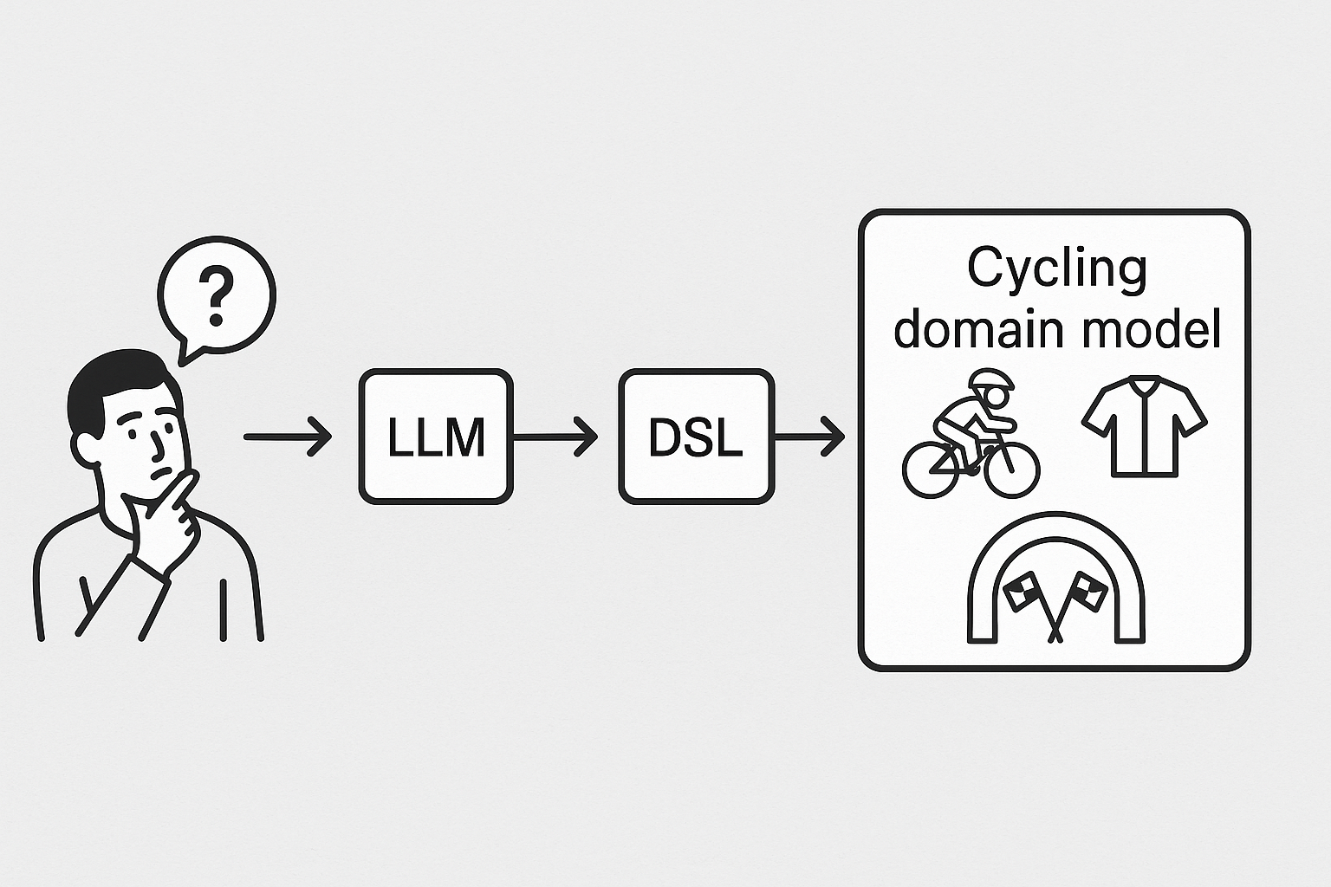
Best of both worlds – Separation of concerns
LLMs offer accessibility — natural, flexible, easy for anyone to use
DSLs offer reliability — structured, validated, rule-bound
What if each did what it’s best at?
LLMs understand intent → DSLs ensure correct execution
Together: Conversational DSLs — natural input with guaranteed validity
Notes:
Clean separation of responsibilities
LLM =Conversation/ UI layer
DSL = business logic layer Pipeline mental model Nobody compromises their strengths

Slide 9
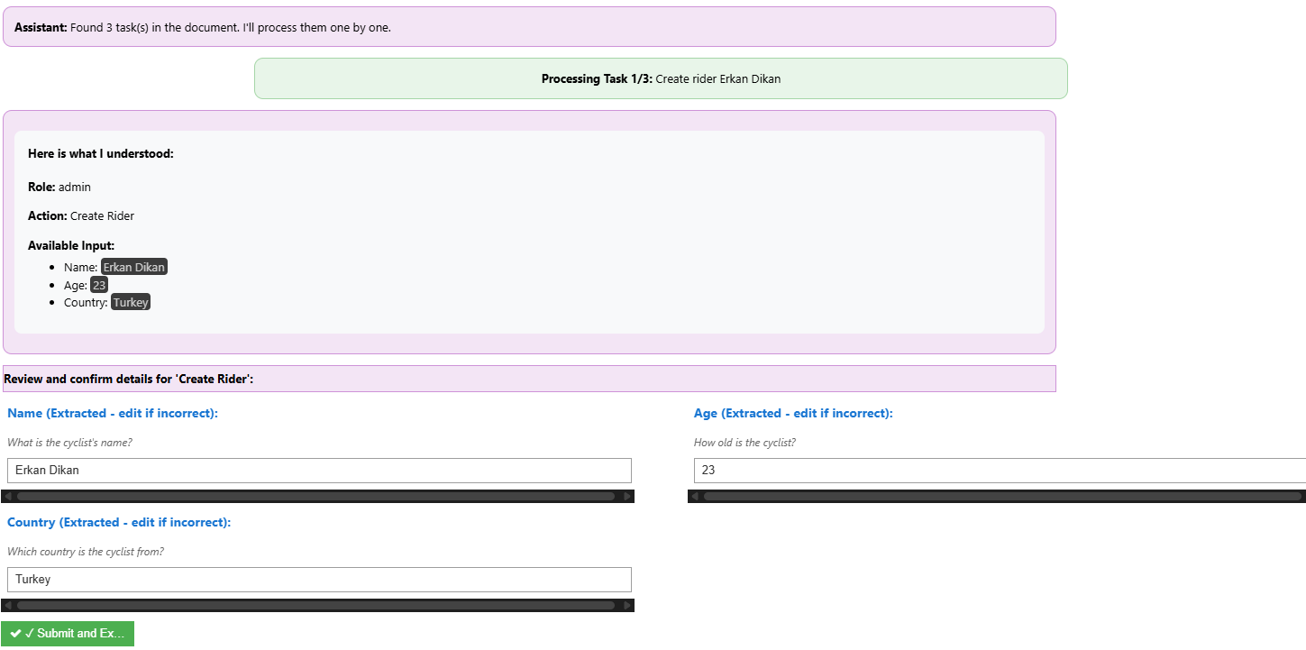
Demo (first part - to show how the envisioned system could look like)
Making the point “If we could use natural language to interact with the underlying model, this is what it would look like”.
Show how an input like this results in model change
““Let's set up the cycling team for next season. Create a rider named Erkan Dikan from Turkey aged 23. Create another rider Priya from Germany. Also create Team SkyIN from India with a budget of 20 million founded in 2010.”
Notes:
Natural language, complex intent Multiple entities, one sentence System figures out the details Proper validation still happens

Slide 10
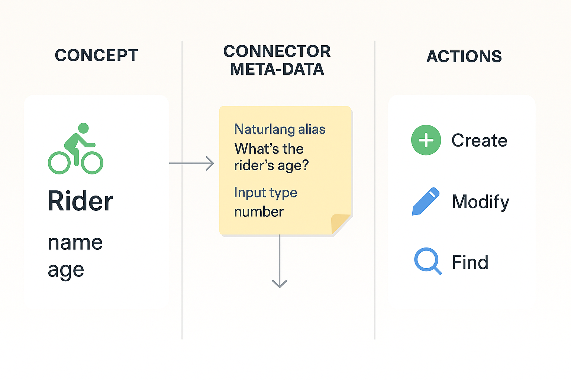
Keeping roles separate with Connector
LLM never touches domain
DSL defines all rules
Connector bridges the gap.
Notes:
Connector similar to API contract
Metadata enrichment concept Aliases handle terminology variations
Type checking still enforced
Required fields still required
LLM can't break the model

Slide 11
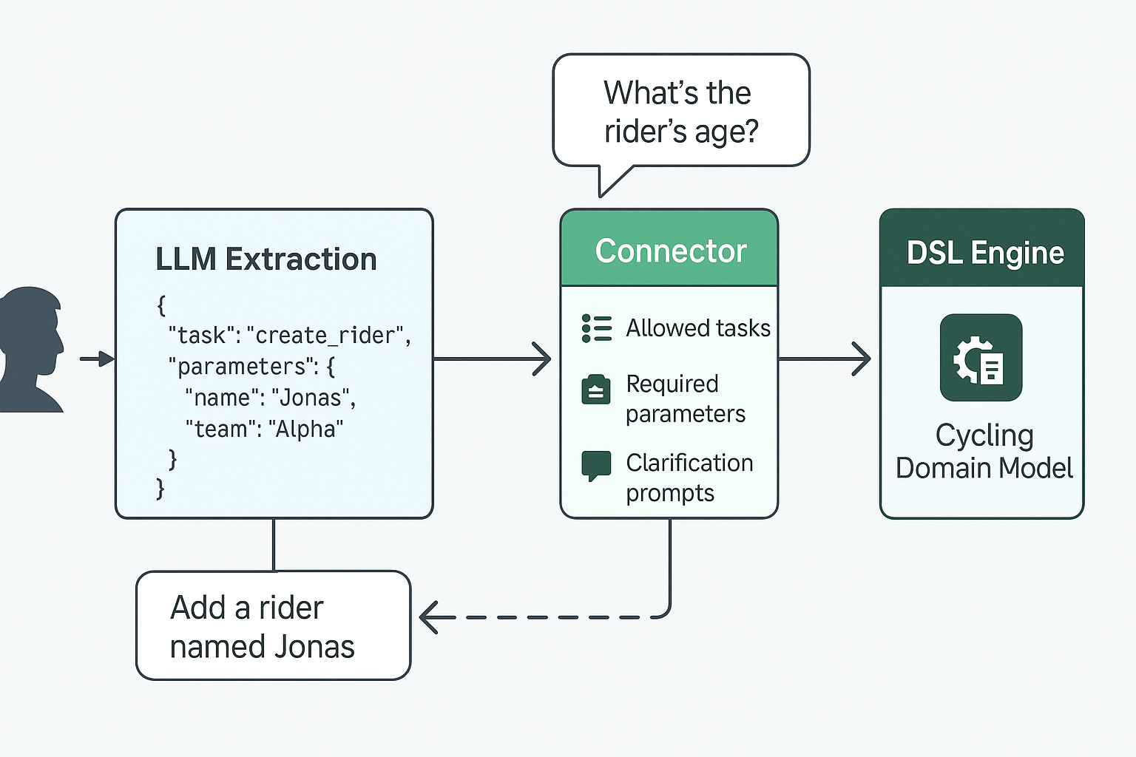
High level system design
LLM extracts intent
Connector validates
Missing info → clarification
DSL executes valid actions
Domain model = source of truth
Notes:
Walk through actual flow User input -> LLM extraction
Connector validation
Clarification loop if needed DSL execution only if valid

Slide 12

Implementation
Two reference implementations
LionWeb (https://lionweb.io/)
Lark (https://lionweb.io/)
Supported model hubs:
Hugging Face
Ollama Cloud
Ollama locally hosted
Notes:
Two implementations prove generality

Slide 13
Demo part 2
Show multiple queries (create, modify, find) in both cycling (lionweb) and event management (lark)
Notes:
Multiple domains working
All CRUD operations
Complex queries
Error reporting

